Slide 1
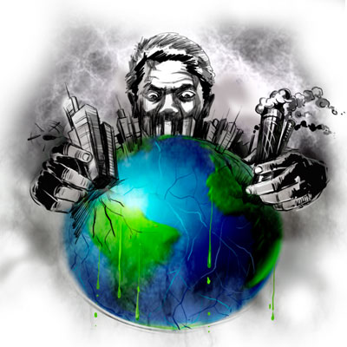
Environmental Pollution
Spasenov Ivan IU7-13

Slide 2
Pollution is the contamination of the environment by introduction of contaminants that can cause damage to environment and harm or discomfort to humans or other living species.
Air
Soil
Water
Environmental pollution consists of five basic types of pollution
Light
Noise

Slide 3
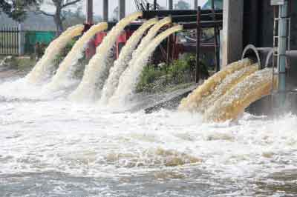
Water pollution
It is the contamination of water bodies (e.g. lakes, rivers, oceans, aquifers and groundwater), very often by human activities.
Water pollution is one of the famous and one of the largest problems in our world. People in Africa cannot drink clean water; their children die because a big part of our water has been polluted. And we do not know how it will be in future.
But the pollute water killed animals and plants too. There is no ocean or sea, which is not used as a dump. Many seas are used for dumping industrial and nuclear waste. This poisons and kills fish and sea animals. "Nuclear-poisoned" fish can be eaten by people.

Slide 4
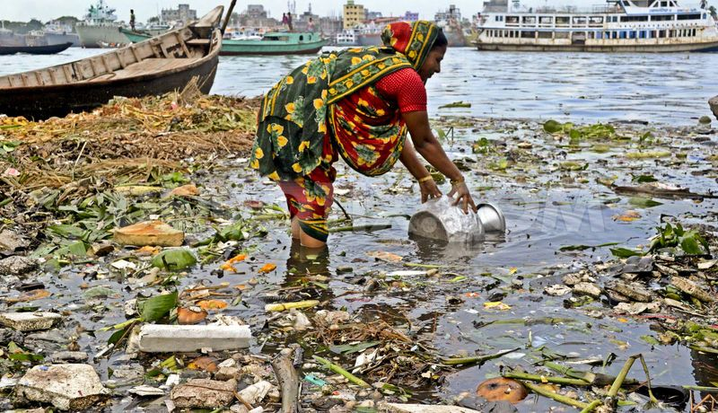
Many rivers and lakes are poisoned too. Fish and reptiles cannot live in them. There is not enough oxygen in the water. In such places all the birds leave their habitats and many plants die. If people drink this water they can die too. It happens so because factories produce a lot of waste and pour it into rivers. So they poison water.
But we MUST keep our planet and water of our planet clean. If we want to live, we should guard our clean water and do not pollute them because we could live without food about a month but without water we could die in 4-5 days. Let's keep our water clean!

Slide 5
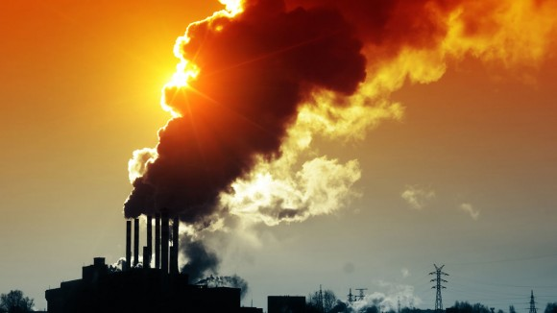
Air pollution
It is a physical, biological or chemical alteration to the air in the atmosphere
There are different kinds of pollution—some visible, some invisible—that contribute to global warming.
Carbon dioxide, a greenhouse gas, is the main pollutant that is warming Earth. It is associated with cars, planes, power plants, and other human activities. In the past 150 years, such activities have pumped enough carbon dioxide into the atmosphere to raise its levels higher than they have been for hundreds of thousands of years.
Other greenhouse gases include methane— which were used in refrigerants and aerosol propellants until they were banned because of their deteriorating effect on Earth's ozone layer.

Slide 6
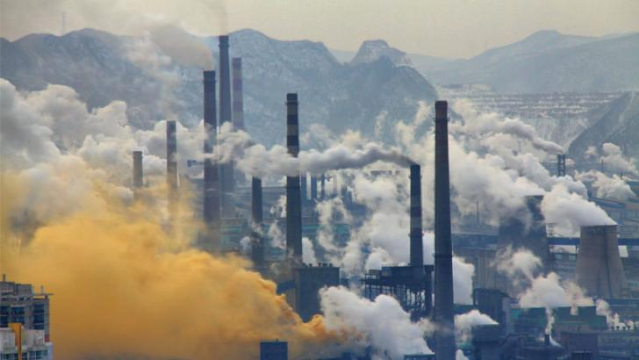
Another pollutant is sulfur dioxide, a component of smog. Sulfur dioxide are known as a cause of acid rain. But they also reflect light. In fact, volcanoes used to be the main source of atmospheric sulfur dioxide; today people are.
Most people agree that to curb global warming, a variety of measures need to be taken. On a personal level, driving and flying less, recycling, and conservation reduces a person’s "carbon footprint"
On a larger scale, governments are taking measures to limit emissions of carbon dioxide and other greenhouse gases.

Slide 7
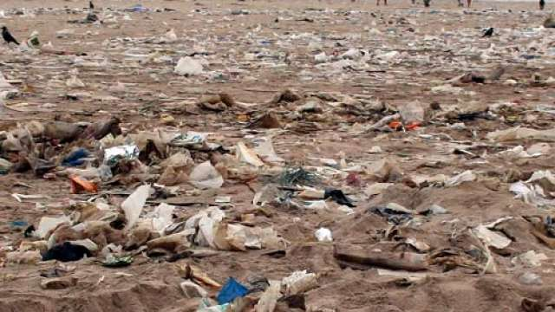
Soil pollution
It is caused by the presence of xenobiotic (human-made) chemicals or other alteration in the natural soil environment.
The major causes of land pollution are construction, domestic waste , industrial waste and agriculture.
The rising construction of building takes away the trees that takes away the homes of the animals living there. As there are more and more people inhabiting on our planet, the demand for food increases and the forests are cut down to make farm lands. In addition, Herbicides, pesticides, artificial fertilizers and animal manure are washed into the soil and pollute it. Tons of domestic waste is dumped everyday from homes offices etc. They can be recycled or burnt in incinerators. There are still more waste machinery products such as refrigerators and washing machines that are dumped in landfills simply because they cannot be recycled. Plastic factories, oil refineries, nuclear waste disposals, and large animal farms, all lead to soil pollution.

Slide 8
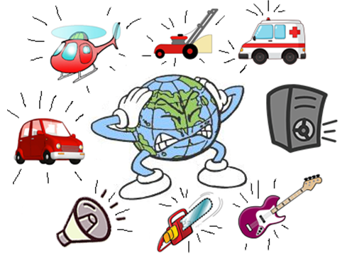
Noise pollution
Noise pollution is the disturbing or excessive noise that may harm the activity or balance of human or animal life. The source of most outdoor noise worldwide is mainly caused by machines and transportation systems, motor vehicles, aircraft, and trains Poor urban planning may give rise to noise pollution, since side-by-side industrial and residential buildings can result in noise pollution in the residential areas. Documented problems associated with urban noise go back as far as Ancient Rome.
Outdoor noise can be caused by machines, construction activities, and music performances, especially in some workplaces. Noise-induced hearing loss can be caused by outside (e.g. trains) or inside (e.g. music) noise.
High noise levels can contribute to cardiovascular effects in humans. In animals, noise can increase the risk of death, interfere with reproduction and navigation, and contribute to permanent hearing loss

Slide 9
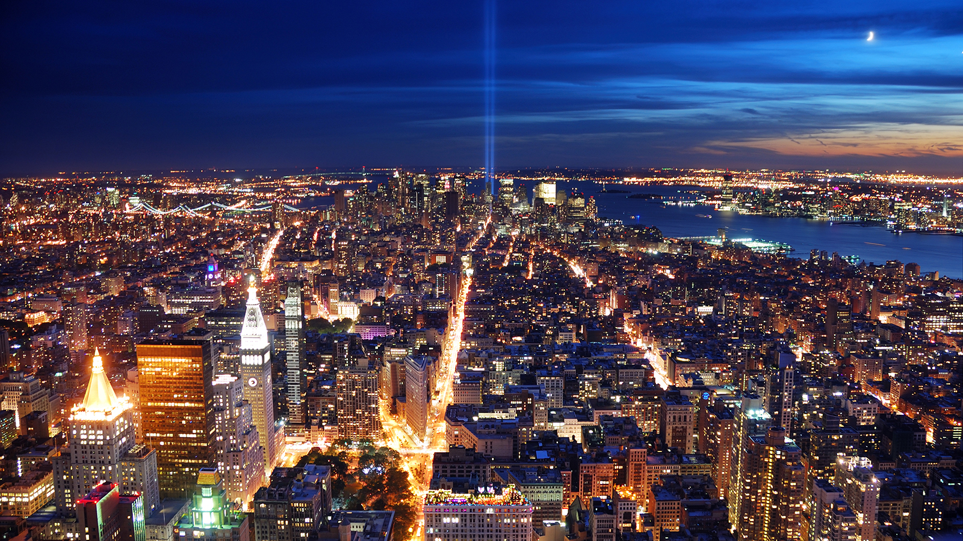
Light pollution
Light pollution or luminous pollution, is excessive, misdirected or obtrusive artificial light. As a major side-effect of urbanization, it is blamed for compromising health, disrupting ecosystems and spoiling aesthetic environments.

Slide 10
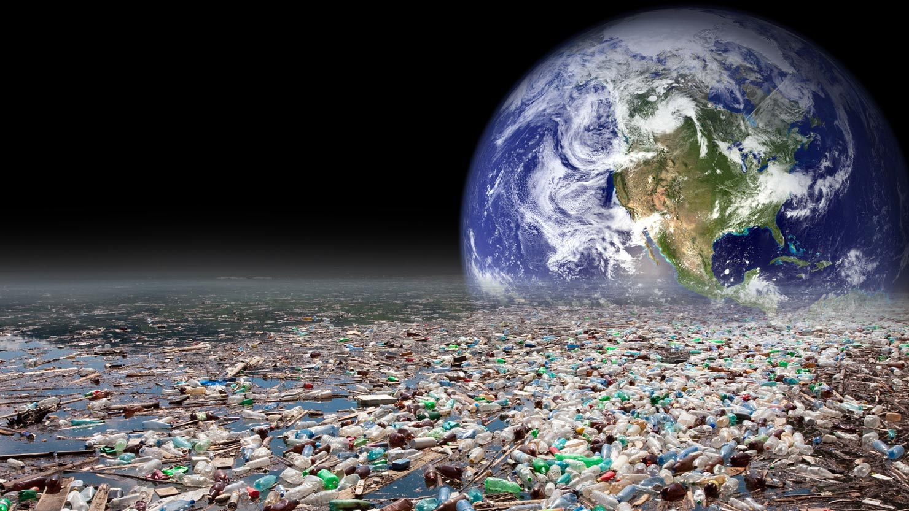
We must protect the environment and prevent pollution. Our future depends only on us!!!

Slide 11
Thank you for attention

